Slide 1
Big Game Census Data Visualization

Slide 2

About
The Super Bowl is the annual final playoff of the National football league to determine the league champion.
It has served as the final game of every season since 1996, replacing the NFL Championship Game.
Since 2022 the game is played on the second Sunday in February.

Slide 3
Objective
To identify where Super Bowl 52 players come from, and important fun facts in the game of Census data of 2016 and 2017.
Perks and Benefits
Identification of the number of players coming from which college
Helped in the easy flow of finding insights from the data
Inspection of Variables and finding correlation
Gives better insights into the player’s behavior
Identification of the positions that impact the playing behavior of the players

Slide 4
Data Information
File Name: us census bureau-big-game-census-data-visualization
Data shape: ( 119 * 18)
Number of columns: 18
Column names ( Player name, player jersey number, player position, player age, player weight, years played, player City, Player birth state, Player college, player team, conference, 2016 population estimates, state GE) ID, full GEOID, latitude player birthplace, longitude player birthplace, a number from the city, a number from records)
Data types (integer, string)

Slide 5
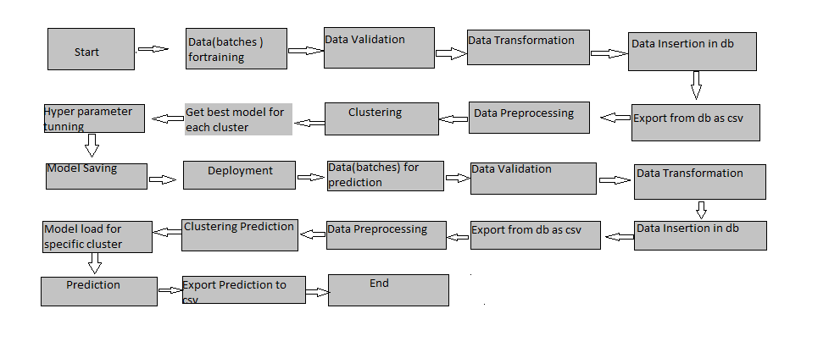
Architecture

Slide 6
Process
Understanding the problem statement
Firstly it’s an important step to understanding the problem statement of the project in order to achieve the end goal from the respective dataset.
Using the Kanban board provided by the ineuron, the structure is been divided into four groups To do, In the process, Backlog, Completed
The complete process and the task segmentation were clearly noted down in the section backlog
Based on the workflow each allotted was being dragged to the respective section of the Kanban board accordingly. The project involved the following stages as mentioned below.

Slide 7
Data Gathering
Initially, we gather data from different sources such as yahoo sports, and the US census. After proper analysis based on the required collective associated fields, it undergoes the next stage of the process.
Data Pre-processing
Once the data is gathered from all the required sources, it is pre proceeds which involves
Data cleaning (sorting, filtering)
Data imputation indicates filling in all the missing data based on the data types and the requirement of the objective.
After the following process, the data is imported into the database in order to help users in the further analysis process. The data is managed using the various database management system i.e. SQL, MySQL, PostgreSQL, etc

Slide 8
Data Analysis
To draw meaningful insights from the data, it’s further required to analyze to fetch an appropriate answer to the questions. It is a very crucial step in analytics, in which by using exploratory data analysis we interpret the graphical observations.
Data Modelling and Evaluation
Based on the analysis, a machine-learning model such as clustering is built up to understand the crux of the analysis and predict the new player to which group it belongs.
Also, it helps in classifying the players who belong to a specific country, team, or birthplace.
To check the accuracy of the model evaluated based on the evaluation metrics score.

Slide 9
Model Training:
Data Export from The accumulated data from DB. is exported in CSV format for model training
Data Preprocessing
Performing EDA to get an insight into data like identifying distribution, outliers, trends
among data, etc.
Check for null values in the columns. If present imputes the null values.
Encode the categorical values with numeric values.
Perform Standard Scalar to scale down the values

Slide 10
Data Visualisation
The complete findings are presented effectively in the form of a dashboard and presented to the stakeholder for a clear view of the solution to make the best business growth.
Deployment
Before this stage of deployment it goes under SIT and UAT process When the model is ready we deploy it in a fire environment where SIT and UAT are performed over it.
Once we get sign-off from the fire we deploy to the earth and UAT is performed over it. After getting the sign-off from the earth we deploy it in production.
Production
After the complete deployment and UAT process is completed it undergoes the production stage.

